Slide 1
Airline Passenger Satisfaction
(Supervised Machine Learning regression )

Slide 2
Problem Statement:
The objective or goal of this project is to guide an airlines company to determine the important factors that influences the customer or passenger satisfaction.
Customer satisfaction plays a major role in affecting the business of a company therefore analyzing and improving the factors that are closely related to customer satisfaction is important for the growth and reputation of a company.

Slide 3
WORK FLOW
Data Collection
and
Understanding
Data Wrangling & Feature Engineering
EDA
Model Selection and Evaluation
Preparation of data for model building.
Conclusions

Slide 4
DATA COLLECTION and UNDERSTANDING
Gender
Customer Type
Age
Type of Travel
Class
Flight Distance
Inflight WIFI service
Departure/Arrival time convenient
Ease of Online booking
Gate location
Food and drink
Online boarding
Seat comfort
Inflight entertainment
On-board service
Leg room service
Baggage handling
Checking service
Inflight service
Cleanliness
Departure Delay in Minutes
Arrival Delay in Minutes
satisfaction

Slide 5
We had a Airplane Flight Passenger Satisfaction Data for our analysis and model building.
The dataset contains satisfaction information , Select the best predictive models for predicting passengers satisfaction.
In this we had total 129880 observations and 25 features including target variable.

Slide 6
Data Wrangling and Feature Engineering:
As we know we had 129880 observations and 25 features.
Categorical Features: Gender, Customer Type and Type of classes, flight distance, satisfaction.
Numerical Columns:
We had zero null values in our dataset.
Zero Duplicate entries found.
We Created two new columns with the help of Date .Which were further used for EDA. And later we dropped Date column.

Slide 7
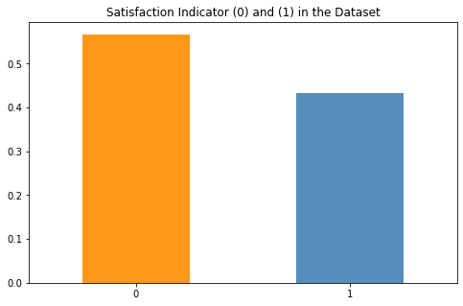
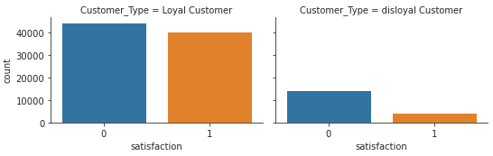
EDA
The above plot shows a distribution of around 55:45 between neutral/dissatisfied passengers and satisfied passengers respectively. So the data is quite balanced and it does not require any special resampling methods to be implemented.
Gender: It is observed that gender distribution of neutral/dissatisfied and satisfied customers are similar. For both male and female passengers, number of neutral/dissatisfied customers are on the higher when compared to number of satisfied customers.
Customer Type: Even among loyal passengers which are high in number, the ratio of satisfied and neutral/dissatisfied ones are almost close to 49:51.

Slide 8
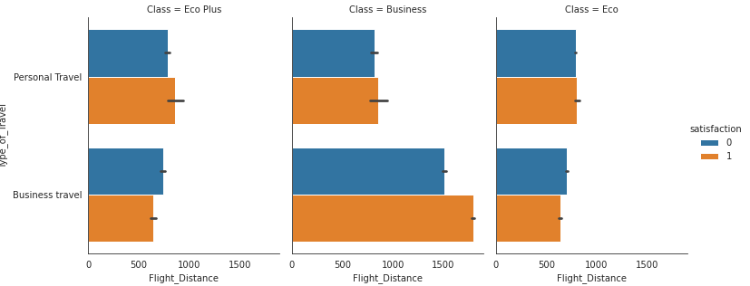
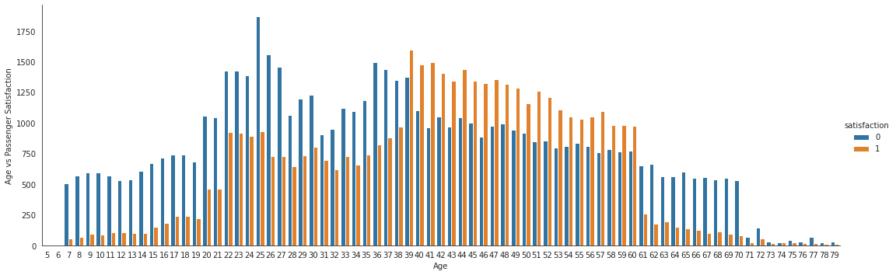
EDA
Type of Travel and Flight Distance grouped by Class: For business travel in business class category, the number of satisfied passengers are quite on the higher for longer flight distance. For other combinations, almost equal distribution of satisfied and neutral/dissatisfied passengers is present.
Age: From age 7-to-38 and from age 61-to-79, the number of neutral/dissatisfied passengers is very high compared to satisfied passengers. On the other hand, in age group 39-60, the number of satisfied passengers is higher compared to neutral/dissatisfied passengers.

Slide 9
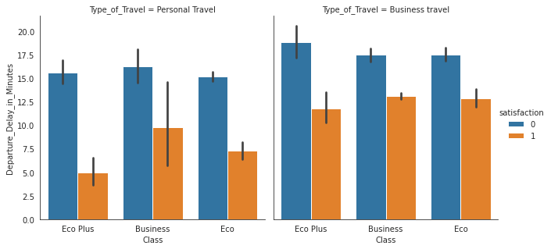
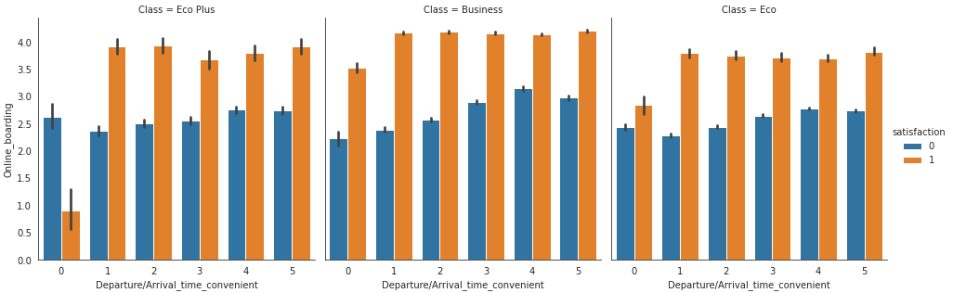
EDA
Departure Delay, Arrival Delay grouped by Type of Travel: For personal type of travel (specially for classes Eco Plus and Eco), the number of neutral/dissatisfied passengers are really high when arrival delay is high which is quite obvious. By minute comparison, all combinations have higher number of neutral/dissatisfied passengers compared to the number of satisfied passengers.
Online Boarding, Departure/Arrival Time Convenience grouped by Class: For Eco Plus class, very inconvenient Departure/Arrival time i.e., Departure/Arrival_time_convenient = 0 has high number of neutral/dissatisfied passengers, even when online boarding is on positive side. For other combinations, the number of satisfied passengers are higher compared to number of neutral/dissatisfied passengers.

Slide 10
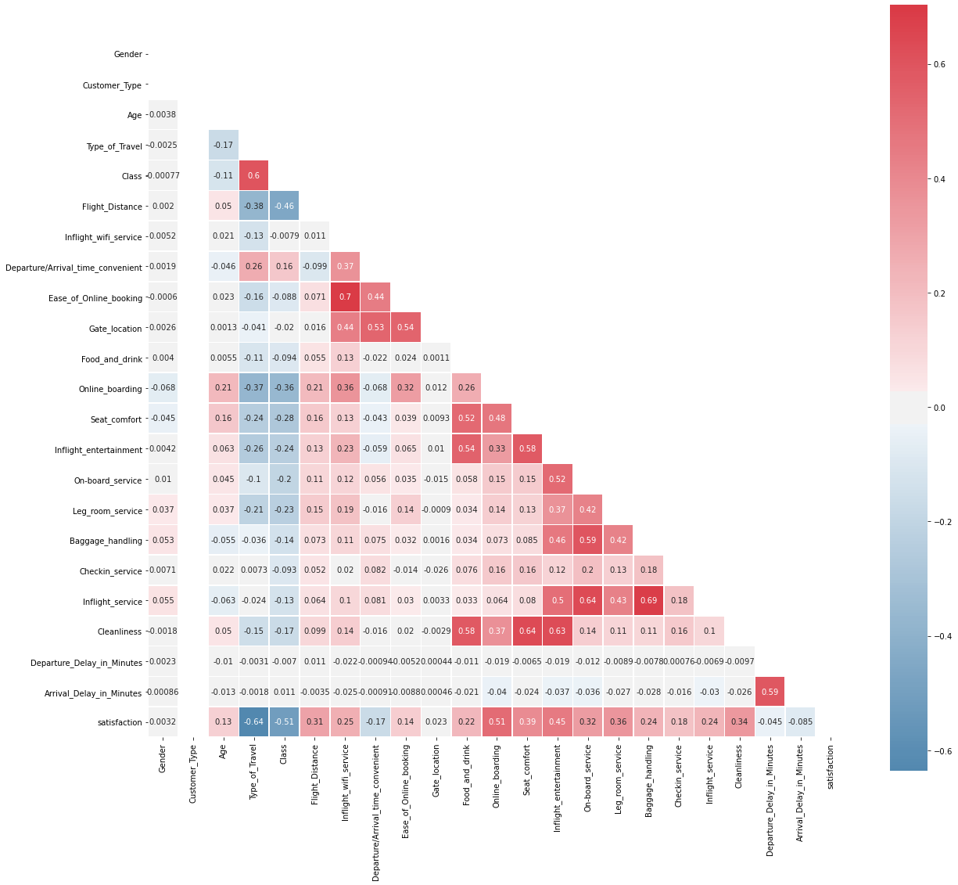
EDA
"Ease_of_Online_booking" is highly correlated with "Inflight_wifi_service" and "Inflight_service" is highly correlated with "Baggage_handling". But no pair is having corrrelation coefficient exactly equal to 1. Therefore there is no perfect multi-collinearity. Hence we are not discarding any variable.

Slide 11
Model Selection and Evaluation
Eight models are used in this project to check for maximum efficiency. They are,
Logistic Regression
Naive Bayes
KNN
Decision Tree
Neural Network
Random Forest
XGBoost
AdaBoost

Slide 12
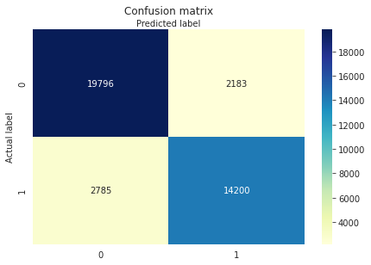
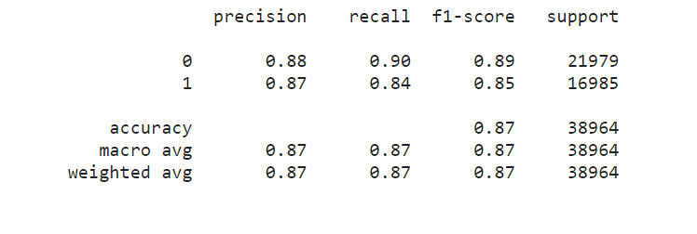
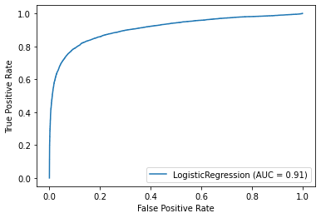
Logistic Regression

Slide 13

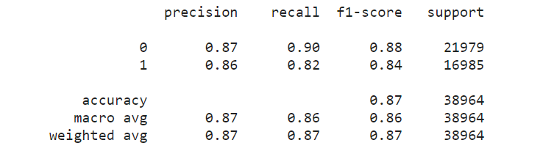
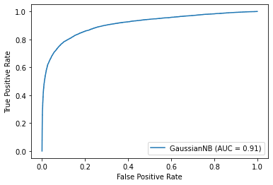
Naïve Bayes Classifier

Slide 14

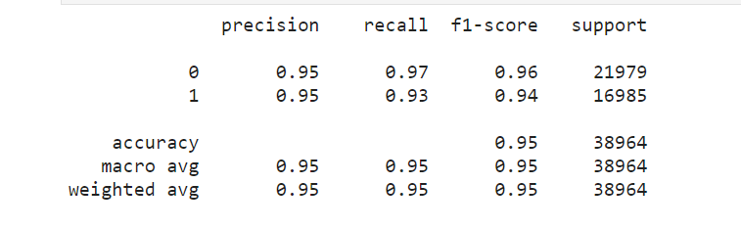
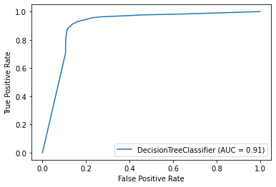
Decision Tree Classifier

Slide 15

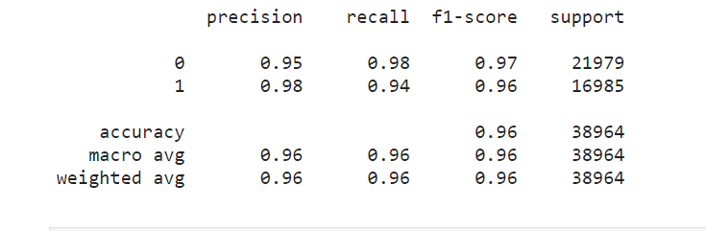
Random Forest Classifier

Slide 16

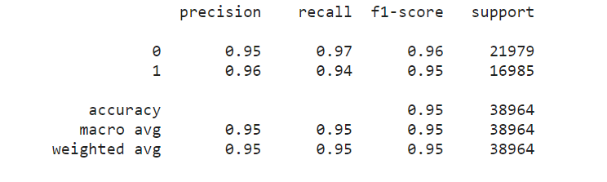
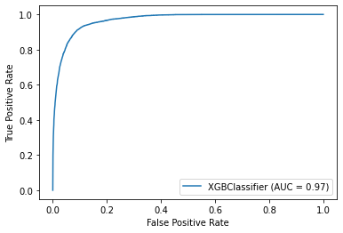
Support Vector Machine

Slide 17

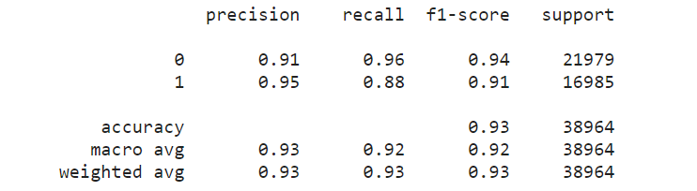
K Nearest Neighbors

Slide 18
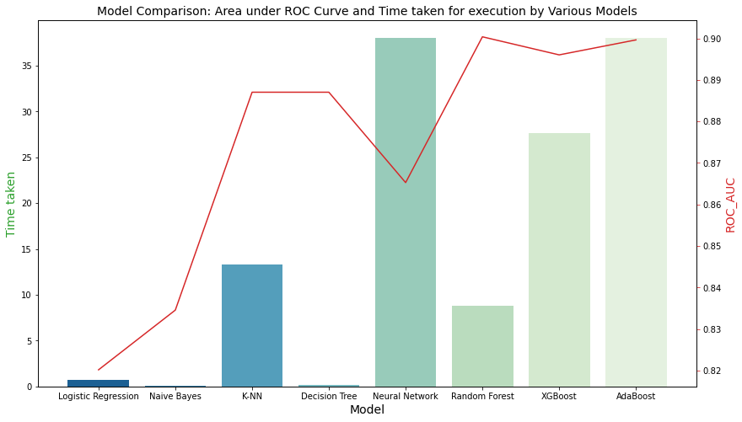
Model Comparison
Compare the performances of the above discussed models with respect to their ROC_AUC score and total time taken for execution.

